Slide 1
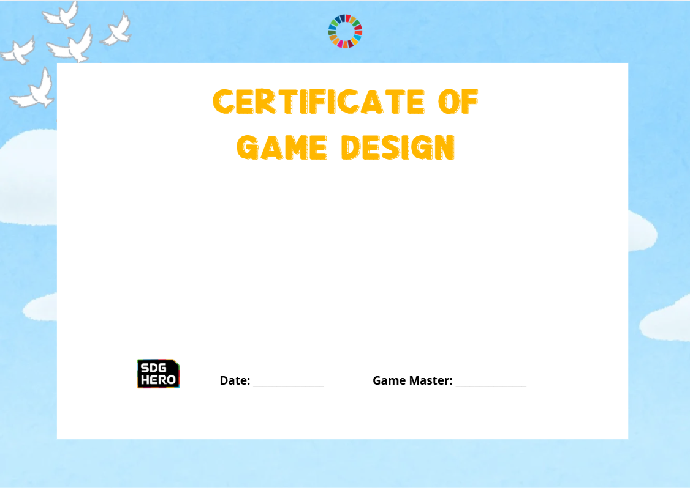
To our Young SDG Hero:
_________________________
For successfully completing the SDG Hero Workshop.
Today, you explored global challenges, co-designed creative solutions,
and proved that the next generation is ready to build a sustainable future.

